Slide 1
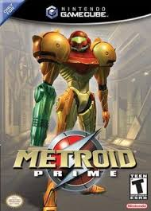


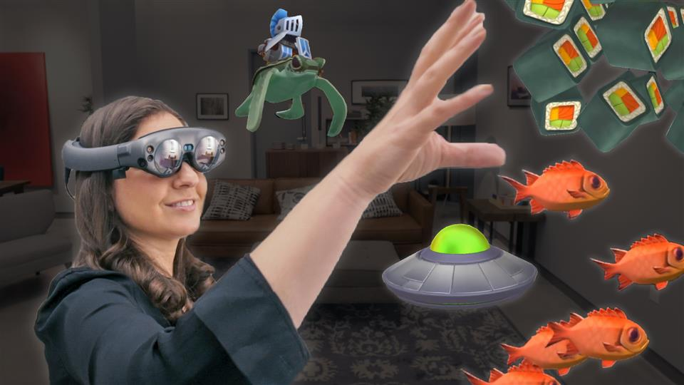


Mr. Johnson’s work as a programmer
(Contractor)
Magic Leap

Slide 2
Goals
Variable Scope
Intro to Objects
Object Lifespan
Learning fundamental concepts will help you do your assignments. The goal is to keep you from getting stuck.

Slide 3
Variable Scope
A variable’s scope refers to the area of the code where it is defined.
The overall rule is a variable is only defined within its surrounding curly braces.
{
int v = 12; // v is defined here
}
// v no longer exists. It has “gone out of scope”.
v = 3; // this is an error. There is no defined variable ‘v’ here.

Slide 4
Variables defined in a function are “local variables”. They go out of scope at the end of the function.
public void function()
{
int x = 6; // local variable x
int y = 4; // local variable y
double pi = 3.1415; // local variable pi
System.out.println(“x = “ + x);
} // <- once execution reaches here, x, y, and pi no longer exist

Slide 5
More local variables
public void function()
{
doSomething();
doSomethingToo();
// The scope each variable actually starts where it is defined
int y = 4; // y is defined from here to the }
int a = y; // y is defined here
}

Slide 6
Class member variables
public class Student
{
public String name; // <- member variable ‘name’
public int id; // <- member variable ‘id’
public void SetName(String n)
{
name = n; // ‘name’ is within its surrounding braces {}
}
}

Slide 7
Function arguments
public void SomeFunction(int someArg)
{
// The scope of someArg is the entire function even though it is technically defined outside the scope of the curly braces
}
public void SomeOtherFunction(int x)
{
someArg = 12; // no such variable ‘someArg’
int y = x; // x is of course in scope
}

Slide 8
For loops – variables defined within the braces
public void Func()
{
for (int i = 0; i < 10; ++i) // ‘i’ is defined in this line
{
System.out.println(i); // and is within scope in the {}
int j = i + 1; // j exists from here to the next ‘}’
System.out.println(j);
}
// references to ‘i’ here will create an error
int y = i; // error, ‘i’ is not defined here. It is out of scope.
}

Slide 9
public void Func()
{
for (int i = 0; i < 10; ++i)
{
System.out.println(i);
}
// but we can reuse ‘i’ again without a problem. Each ‘i’ is separate.
for (int i = 5; i < 20; ++i)
{
System.out.println(i);
}
int i = 4; // This ‘i’ is a separate variable from the earlier ones
}

Slide 10
Variable scope
You create variables by defining them and they exist from the line that defines them until the next closing brace ‘}’.
Variables defined in a for-loop are in scope inside the loop
Function arguments are defined within the function
Member variables are part of an object and follow the rules for an object. (Coming up)

Slide 11
Object Lifespan
Creating Objects and Deleting objects
Variables exist within their scope. Objects exist in time within their lifespan.

Slide 12
Objects
Objects are just “things” in programming. They tend to be the nouns when you describe a problem. Your assignment 7.3 has Horses inside of Horsebarns. Horses and Horsebarns are two objects in that problem.
In Java, anything that is not a base type such as “int”, “float”,and “double” is an object.
Classes are the definitions for objects but are not objects themselves

Slide 13
Classes define objects but are not objects
public class Horse // from assignment 7.3
{
public String name;
public int weight;
public Horse(String n, int i) // <- constructor
{
name = n;
weight = i;
}
}
The Horse class defines objects of type Horse. This one has one constructor.
A constructor ‘constructs’ an object. You must call a constructor to create an object.

Slide 14
Creating an object is called instantiating it
public void SomeFunc()
{
// Use the ‘new’ keyword to call a constructor for Horse
Horse h = new Horse(“Trigger”, 485);
System.out.println(h.name + “, “ + h.weight);
}

Slide 15
Instantiating an object
Horse h = new Horse(“Trigger”, 485);
Horse
h
name :Trigger
weight : 485
This is an instantiated object
The variable ‘h’ only refers to the object. It is not the object.

Slide 16
Adding a second reference
Horse h = new Horse(“Trigger”, 485);
Horse winner = h; // second reference to the same object!
Horse
h
name :Trigger
weight : 485
winner
This is an instantiated object
Now two variables refer to the one object. You can tell that there is only one object because ‘new’ was only called once.

Slide 17
What happens when we change the object?
Horse h = new Horse(“Trigger”, 485); // this creates the object and a ref ‘h’
Horse winner = h; // second reference to the same object!
winner.weight = 555; // change the weight of the winner horse
Horse
h
name :Trigger
weight : 555
winner
These are the references
to the object
This is an instantiated object
The weight field of the object is changed from 485 to 555. h.weight is 555. winner.weight is also 555. They refer to the same weight of the same horse.

Slide 18
Objects as function arguments
public void SetWeight(Horse h, int w)
{
h.weight = w;
w++;
}
public void Func()
{
Horse fred = new Horse(“Fred”, 450);
SetWeight( fred, 455);
}
A copy of ‘fred’ is passed in and becomes h. The value 455 is passed in and becomes ‘w’
Horse
h
name :Fred
weight : 455
fred
This is an instantiated object
Inside SetWeight(), Fred and ‘h’ are references to the same object! Changing h inside SetWeight() changes fred. This is usually what you want.

Slide 19
Confused? Google “Java pass by value”
All function parameters in Java are “pass by value”. Objects can only be passed to functions by the value types that refer to them. In other words, the references to the objects are passed to the functions.

Slide 20

When all the references to an object go out of scope, Java marks the object for death.
public void UselessFunctionForIllustration()
{
Horse fred = new Horse(“Fred”, 555);
Horse h = fred;
Horse y = fred;
} // references fred, h, and y all go out of scope here. They cease to exist.
Horse
Then the references go out of scope
Horse
fred
name :Fred
weight : 555
name :Fred
weight : 555
This object has been left without any references! It still exists in the computer’s memory but it is lost forever to the program. It is garbage. This is because the references ‘fred’, ‘h’ and ‘y’ no longer exist.
h
y
This is an instantiated object

Slide 21
A program can find itself with millions of garbage objects
Java occasionally wakes up it garbage collector and removes the garbage objects to make room for new objects. Objects take up memory in your computer so this process frees up that memory for new objects.
Horse
Horse
Horse
name :Dude
weight : 444
name :Candy
weight : 325
name :Trigger
weight : 203
Java frequently pauses your program so that the garbage collector can run. Minecraft is known to pause for 25ms. My TV sometimes freezes for several seconds when I use the remote and I blame the garbage collector.

Slide 22
Object Lifespan summary
Java objects are created by calling new on a constructor and keeping a reference to the object
Horse fred = new Horse(“Fred”, 555);
Java objects are deleted when the garbage collector removes all the objects that no longer have any references. Normally you just write code and don’t worry about it. When the references go out of scope, Java will take care of it for you.
It’s not that simple. But we will pretend it is for this class.

Slide 23

Oh, and references can be ‘null’.
An object reference that is null refers to nothing.
public void DoSomething()
{
Horse fred = new Horse(“Fred”, 555);
fred = null; // the only reference has been set to null
}
Horse
fred
name :Fred
weight : 555
This object has become garbage the moment its only reference was set to null.

Slide 24
Trying to access a member variable through a null value.
public void DoSomething()
{
Horse fred = null;
fred.weight = 340; //Error: Bad! This error happens when you run the program.
}
fred
Fred does not refer to an object. There is no object with a weight value to set. The error will say that you have attempted to deference a null value. Everyone makes this mistake. And it won’t be as clear as this example how it happened.

Slide 25
Variable Scope
Java variables exist only within the curly braces that surround them. There were a few exceptions but if this is all you remember today, I’ll take it.
public void function()
{
int x = 6; // local variable x
double pi = 3.1415; // local variable pi
System.out.println(“x = “ + x);
} // <- once execution reaches here, x, and pi no longer exist

Slide 26
Done with object lifespan
Didn’t cover default constructors
Didn’t show you various types of constructors
Didn’t cover mutable vs immutable objects
Didn’t cover how Strings are special because they are immutable and use a String Pool
Didn’t cover the heap versus the stack
Didn’t cover lots of stuff… for another day.

Slide 27
Help for your assignment 7.3 (VS Code)
public class HorseBarn {
public void CreateTestData() { // I wrote this function.
Horse h = new Horse("Trigger", 333);
spaces.add( h );
Horse h1 = new Horse("Candy", 444);
spaces.add( h1 );
spaces.add(null);
// or shorter...
spaces.add( new Horse("SeaBiscuit", 555));
} }

Slide 28
Creating an ArrayList and adding Object references to it.
ArrayList<Horse>
spaces = new ArrayList<Horse>();
spaces
(Empty)
ArrayList<Horse>
0
spaces.add(new Horse(“Trigger”, 333));
spaces
Horse
name :Trigger
weight : 333
ArrayList<Horse>
0
1
spaces.add(new Horse(“Candy”, 444));
spaces
Horse
Horse
name :Trigger
weight : 333
name :Candy
weight : 444

Slide 29
ArrayList<Horse>
0
1
2
spaces.add(null);
In your assignment, null means
there is no horse in that space.
spaces
null
Horse
Horse
name :Trigger
weight : 333
name :Candy
weight : 444
ArrayList<Horse>
0
1
2
3
spaces.add(new Horse(“SeaBiscuit”, 555);
spaces
null
Horse
Horse
Horse
name :Trigger
weight : 333
name :Candy
weight : 444
name :SeaBiscuit
weight : 555

Slide 30
This is what the spaces object looks like after calling CreateTestData().
https://scps.webex.com/meet/dillshh
ArrayList<Horse>
0
1
2
3
spaces
null
Horse
Horse
Horse
name :Trigger
weight : 333
name :Candy
weight : 444
name :SeaBiscuit
weight : 555
Useful syntax
spaces.get(0).name is “Trigger”. spaces.get(0).weight is 333.
spaces.get(1).name is “Candy”.
spaces.get(2).name is an error because spaces.get(2) is null.
spaces.get(3).weight is 555.
spaces.size() is the number of items in the ArrayList so it is 4.

Slide 31
VS Code to continue

Slide 32
Base types made copies
public void func()
{
int x = 3; // x contains the value 3. Got it
int y = x; // y makes its own copy of the 3
x = 4; // x is now 4. Changing x does not change y.
System.out.println(y); // y is still 3
}

Slide 33
Base types make copies of their values
public void func()
{
int x = 3;
int y = x;
x = 4;
System.out.println(y);
}
x
3
y
3
y copies the 3 from x
x
4
x becomes 4 but y remains 3

